Slide 1
Optimizing the Route of the DEUTSCHLAND on the Baltic Sea
Ieva Juzumaitė

Slide 2
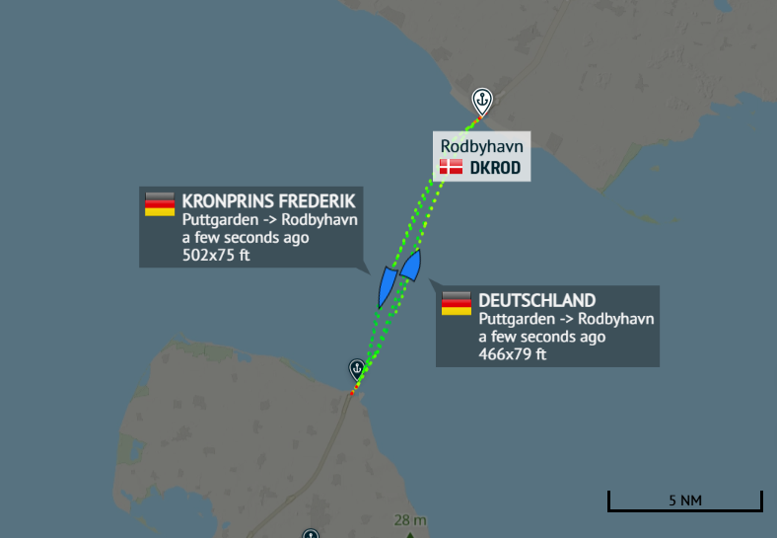
The Story
The dataset consists of 3 ships’ movements on the Baltic Sea: the DEUTSCHLAND, PRINSESSE BENEDIKTE, and PRINS RICHARD.
The DEUTSCHLAND travels between DEPUT and DKROD ports.
The goal of this analysis was to map the optimal routes of the DEUTSCHLAND on the Baltic Sea.

Slide 3
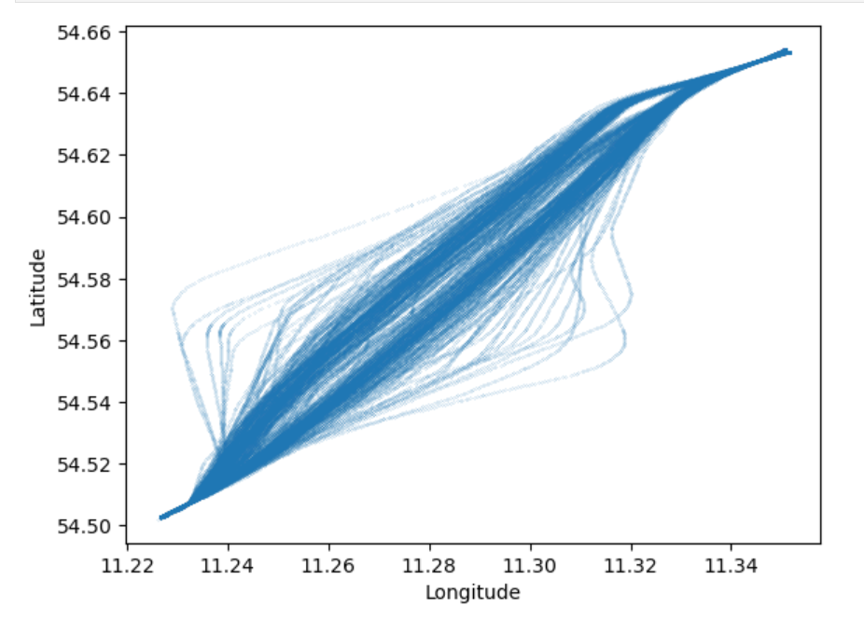
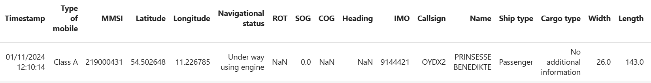
Marine Ship Data Overview
Key data:
Timestamp
Latitude
Longitude
Destination
Route-related variables: rot of turn (ROT), speed over ground (SOG), course over ground (COG), heading
Ship characteristics: MMSI, length, width, ship type, cargo type, etc.

Slide 4
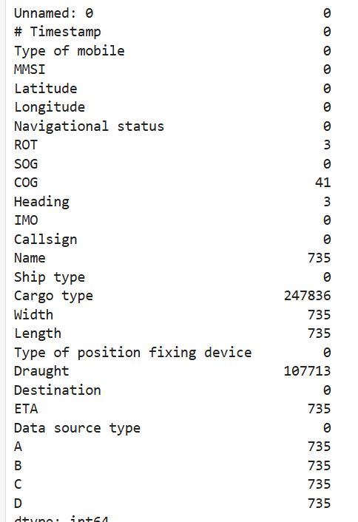
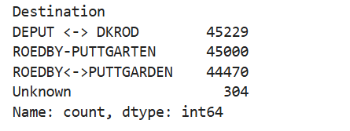
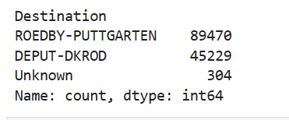
Data Cleaning
Null Values
3 null values for ROT filled as 0, since SOG was 0
3 rows containing null values for Heading were dropped, as there was also no COG info, and speed and ROT were 0
Duplicates
Dropped exact duplicates of rows
Dropped columns that did not provide distinctive information (Cargo type, Data source type, Navigational status, Ship type)
Other actions, such as implementing consistent formatting in the Destination column

Slide 5
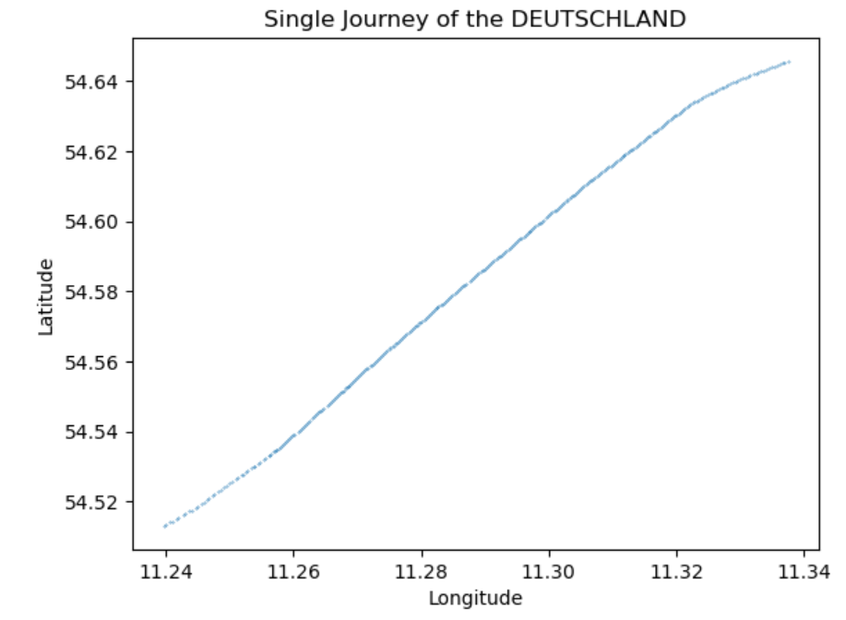
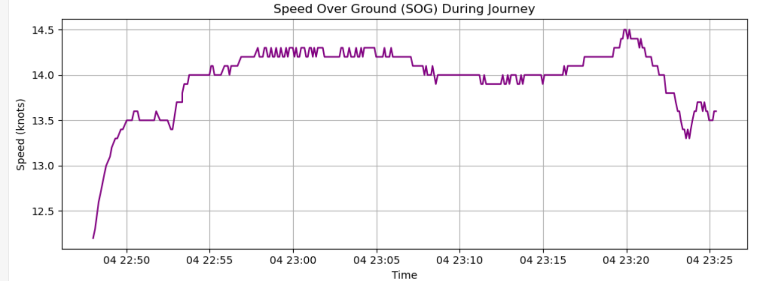
Mapping a Single Journey of the DEUTSCHLAND
8.74 nautical miles
37 minutes and 23 seconds
Threshold of being “close to port”: 0.5nm

Slide 6
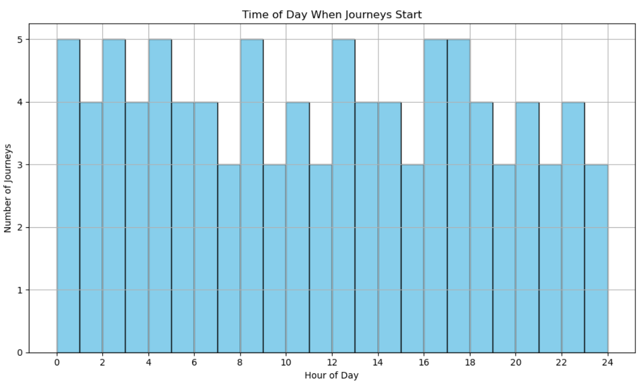
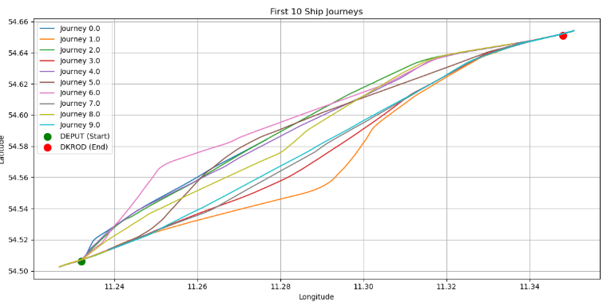
Multiple Journeys
Journey ID (journey_id): created to map each “journey” of the ship
From port DEPUT to port DKROD and from port DKROD to port DEPUT
Is there a way we can find the most optimal route?

Slide 7
Predictive Modeling
Goal: Identify the most optimal routes
Optimal routes arrive to the location smoothly and consistently
Suboptimal routes are more inconsistent with movement (higher frequency of course corrections)
Model: K-Means clustering to classify the DEUTSCHLAND ship’s journey segments into optimal and suboptimal routes
Why K-means clustering?
Interested in seeing the underlying structure in the data, instead of focusing on a target variable
Grouping similar behaviors into meaningful clusters

Slide 8
Feature Engineering
Journey progress: how far along the ship is in the journey
SOG difference (SOG_diff): identifying sudden changes in speed
SOG rolling average (SOG_smoothed): measuring general travel efficiency
COG rolling average (COG_smoothed, Heading rolling average (Heading_smoothed), ROT rolling average (ROT_smoothed): overall trend in direction

Slide 9
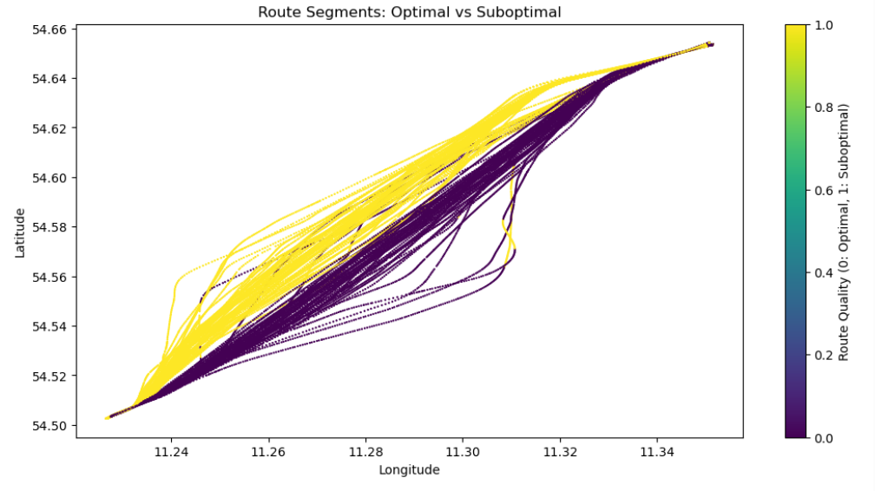
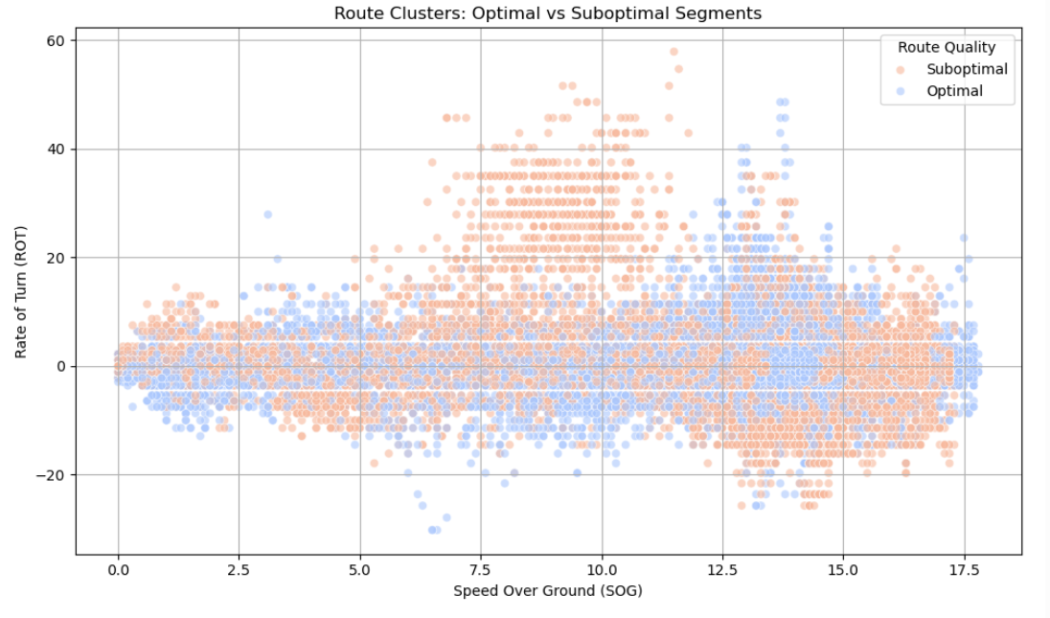
Results from the K-Means Clustering Model
K-Means clustering identified:
Optimal paths: more stable speeds and turns
Suboptimal paths: more erratic or inconsistent

Slide 10
Insights from the Model
Ships with optimal routes are traveling slightly faster but with a more steady speed profile, while ships with suboptimal routes are traveling at a slightly slower speed but have more turning activity.
 | SOG | Average SOG difference | ROT | Average Journey Progress
Optimal Route | 10.985 | -0.000144 | 0.25 | 0.49
Suboptimal Route | 10.327 | 0.00012 | 0.35 | 0.51
Silhouette Score = 0.81
Indicates that the data points in each cluster are cohesive
The clusters are well separated
Based on the Silhouette score, the model was successful in separating DEUTSCHLAND journeys into optimal vs. suboptimal

Slide 11
Implications and Limitations
Future Implications
Limitations
Can be useful in route planning and correction
Maintaining fuel efficiency
Standardizing routes
Can be used to estimate ETA more accurately
Did not take into account factors such as
Weather
Fuel usage
Sea traffic
Only 2 clusters: optimal and suboptimal

Slide 12
Conclusion and Further Exploration
A K-means clustering model was used to determine optimal and suboptimal journeys for the DEUTSCHLAND on the Baltic Sea. It successfully identified optimal paths, containing more stable patterns of movement, and suboptimal paths with more erratic or inconsistent movements.
Further exploration can include:
Predicting estimated time of arrival (ETA) to port
Analyze the other ships’ routes
Compare the two ships that travel from ROEDBY-PUTTGARTEN – does one ship have consistently more optimal routes, and why?
Instead of just optimal vs. suboptimal clustering, including a range of different classifications for a more nuanced model
Which direction is more optimal (DEPUT => DKROD vs. DKROD=>DEPUT), and why?
Adding more features, such as acceleration to the clustering model
Incorporating other data, such as weather, sea traffic, sea condition

Slide 13
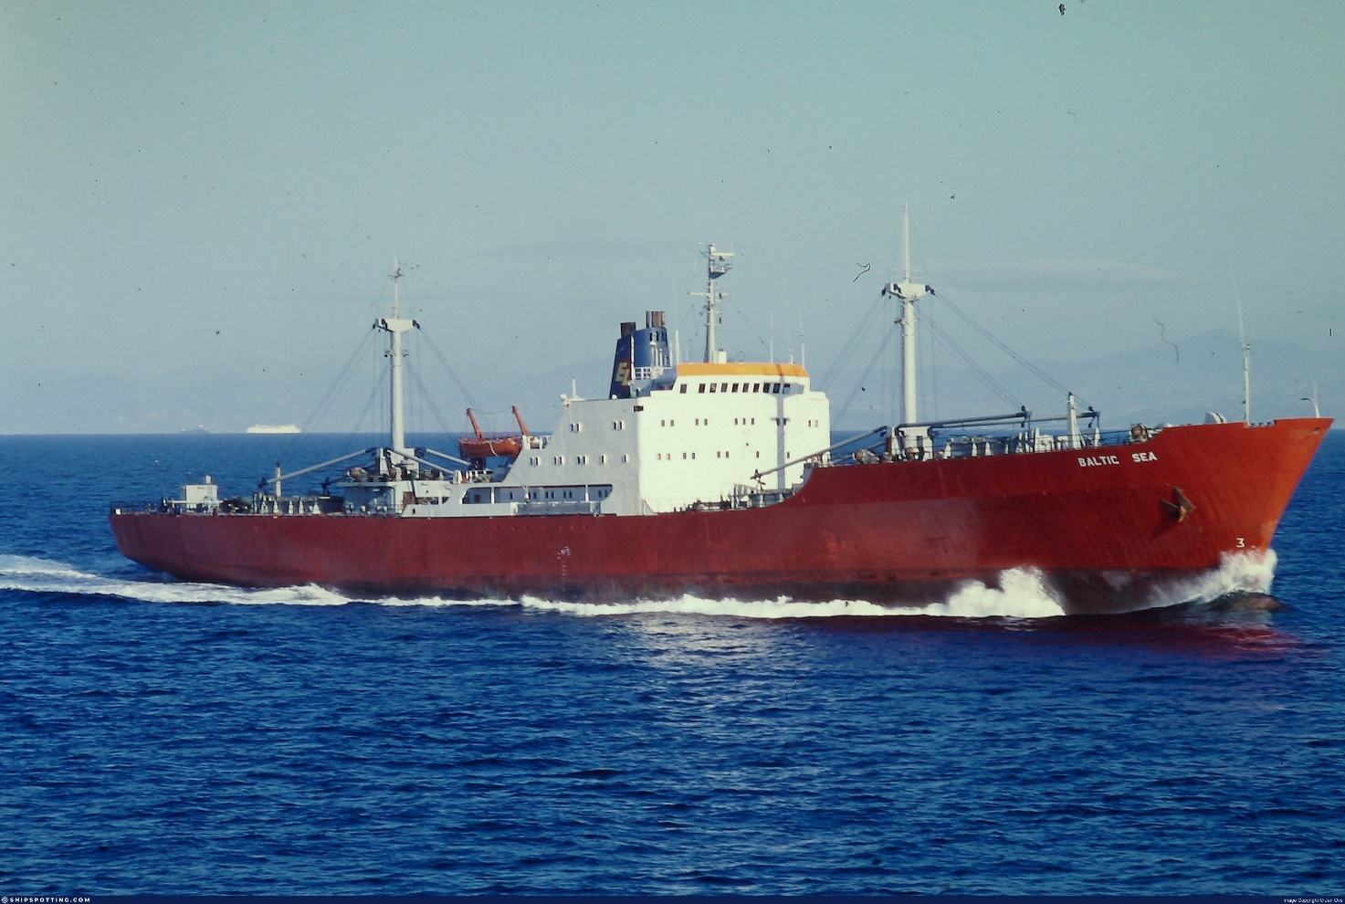
Thank you!
Notes:
https://www.shipspotting.com/photos/big/1/0/4/2204401.jpg?cb=0

